Slide 1


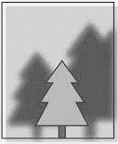







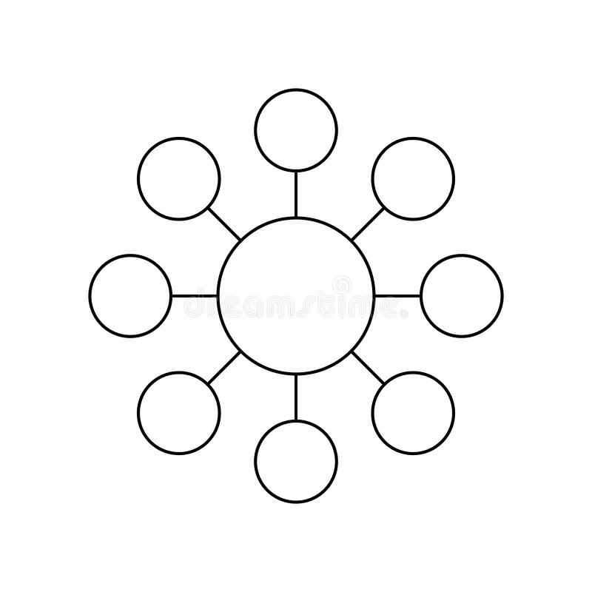





Photography
Learning Journey
Year 10
Understanding and Applying Photography Skills
Year 11
Research
Annotation
Initial ideas
Development of ideas
Plan final piece
Final Piece
Artists / Photographers research
Analysis
Editing
Drawing / sketching skills
Evaluation
Digital manipulation / photoshop
Development of designs
10 hour Exam- Final piece- Personal response.
Photoshoot 2
Exam & Post – 16
Destination
Digital manipulation / photoshop
Term 3
Exam
Analysis of photoshoot 1
Final design
Evaluation
Completion of portfolio of work.
Photoshoot 1
Starting point
Spider diagram
Further development of designs for project 2
Artist analysis
Term 2
EXAM Project
Term 1
Design Ideas
Design Brief
Evaluation of project 2
Evaluation of project 1
Artist analysis
Digital manipulation / photoshop
Photoshoot 2
Development of designs
Evaluation
Further development of designs for project 1
YEAR
Term 3
11
Starting point
Analysis of photoshoot 1
Digital manipulation / photoshop
Final design
Photoshoot 1
Digital manipulation / photoshop
Class trip to Manchester for Photoshoot 2
Design Ideas
Spider diagram
Final design
Development of designs
Project 2 – Texture, pattern & detail
Term 2
Design Brief
YEAR
Spider diagram
Starting point
Photoshoot 1
Analysis of photoshoot 1
10
Project 1 – Urban Landscapes
Term 1
Design Brief
Design Ideas
Artist analysis
Digital manipulation / photoshop

