Slide 1

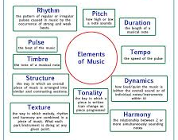
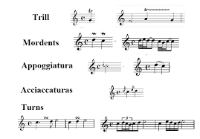
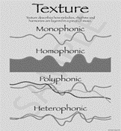
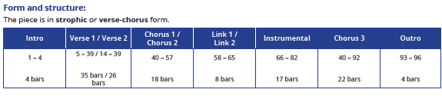
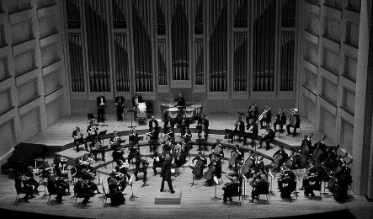


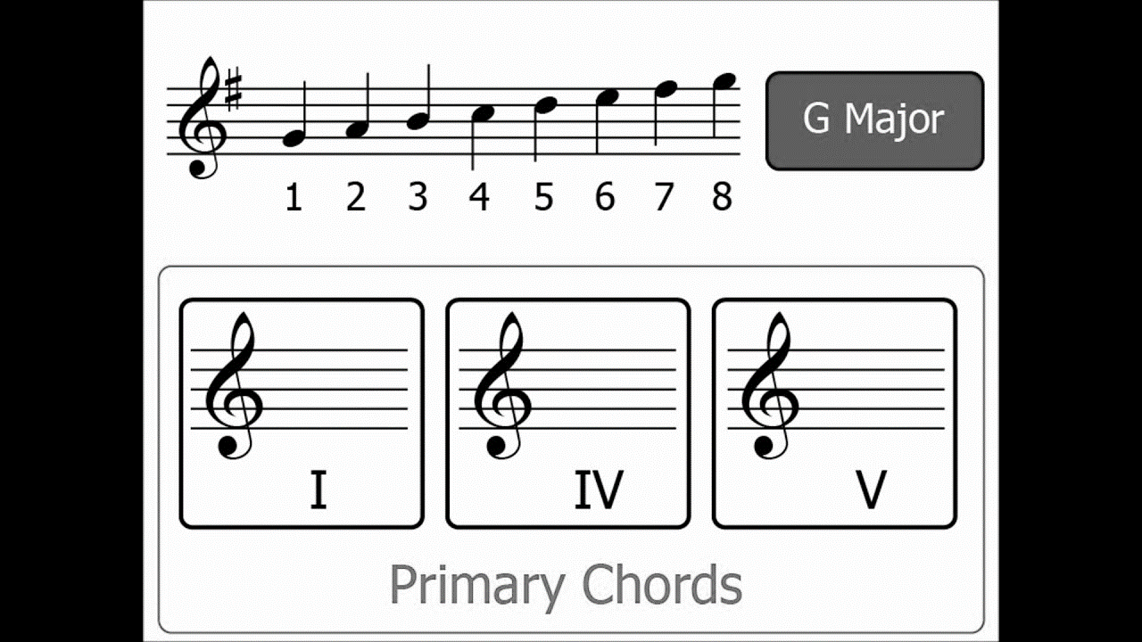
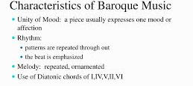



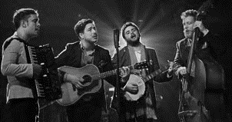
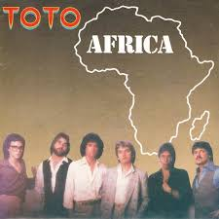

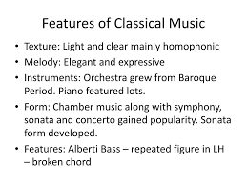
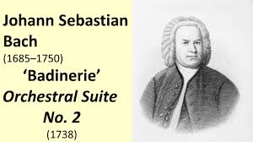

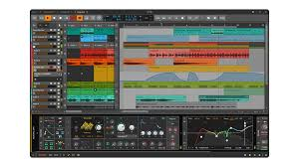




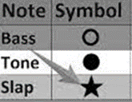
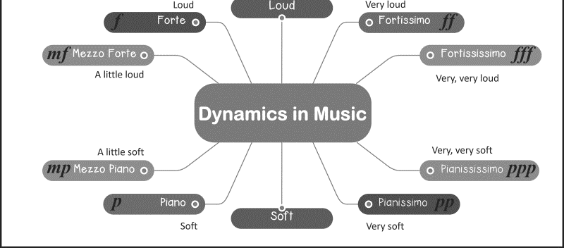


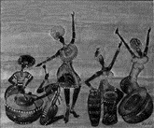
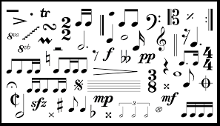
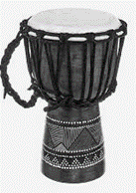
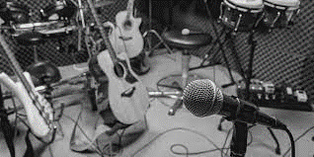
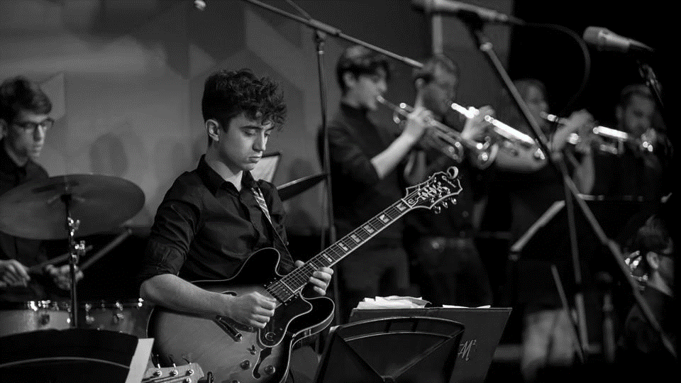
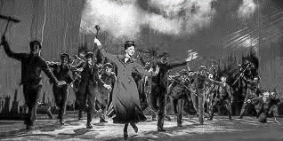
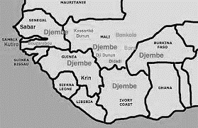

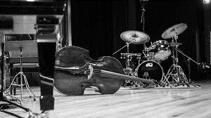
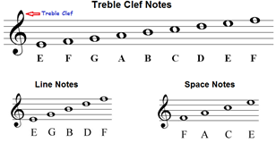
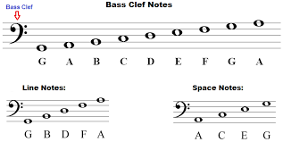
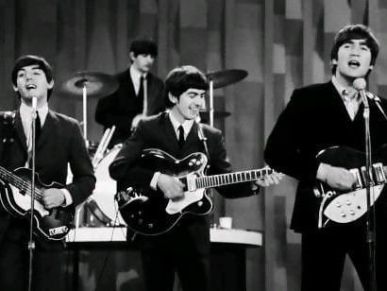
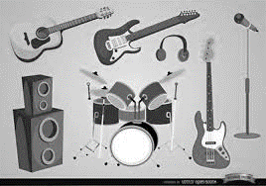

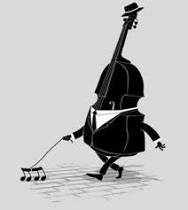
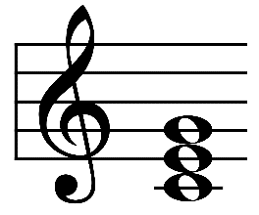
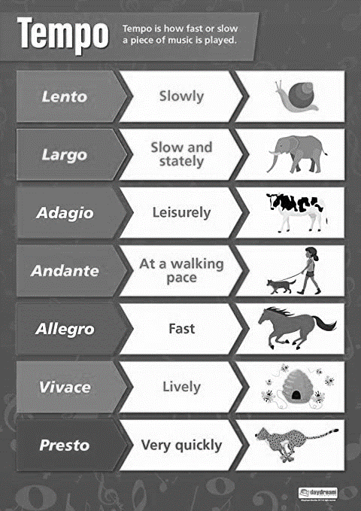
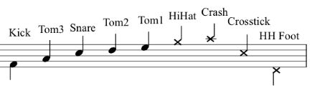

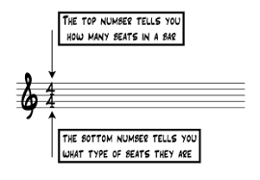
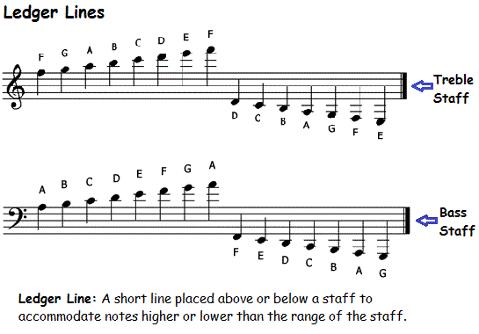


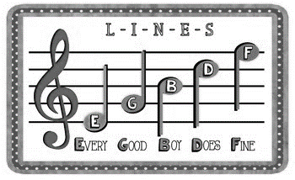
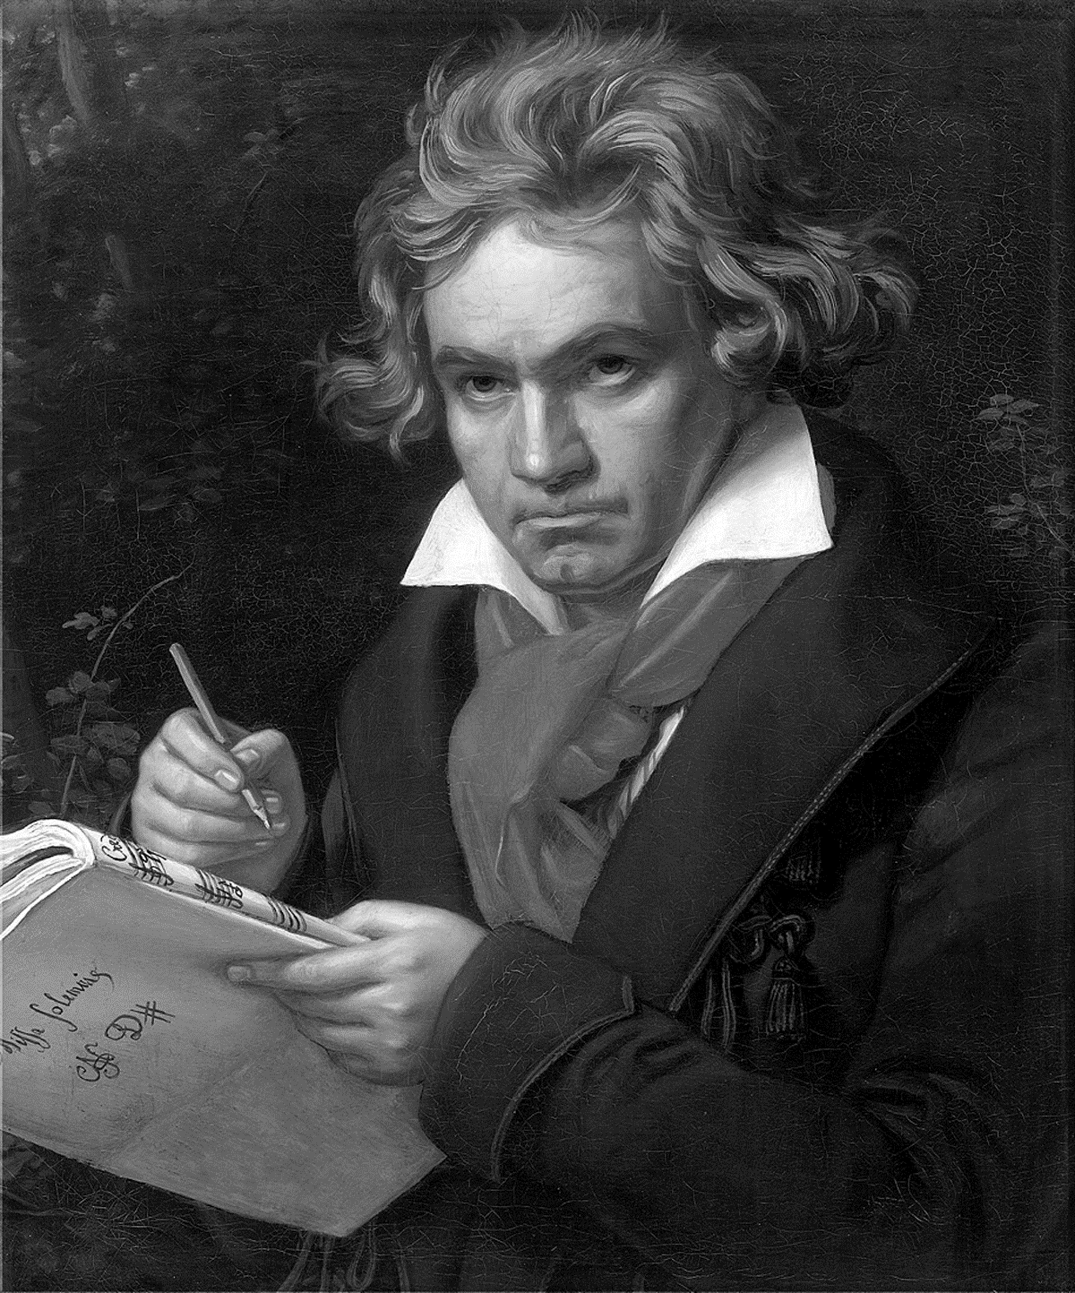
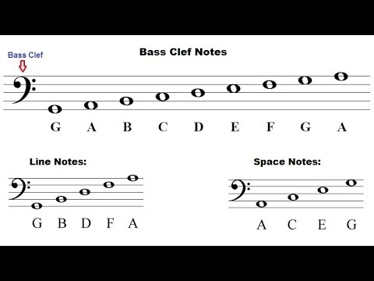
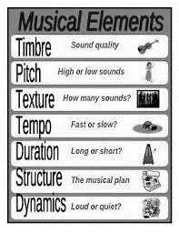



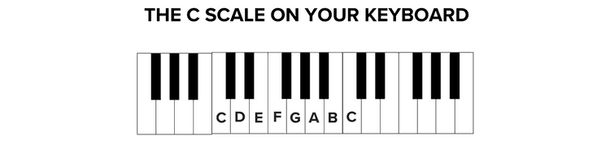
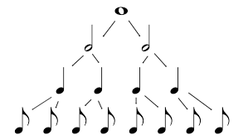

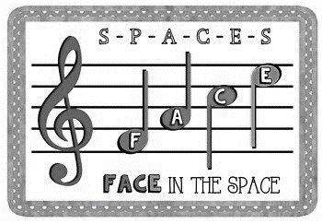

Music GCSE Learning Journey
Year 7
Understanding musical notation, different genres of music and developing performance and composition skills
Year 11
Understanding Rhythm
Understanding the treble clef and the piano keyboard
Developing ensemble skills
Developing creative compositional techniques
Understanding of key musical vocabulary , notation and compositional devices
Understanding of performance directions
Understanding of recording techniques
Ability to perform as a soloist and in an ensemble with accuracy and fluency
Ability to describe musical features in all areas of study
Understanding musical notation – note names/values and rests
Understanding the bass clef
Understanding of music technology
Ability to compose suitable music to a set brief
Developing techniques
Understanding the use of music in the media
Developing aural identification of instruments and musical features
Understanding of different genres and instruments of world music
Developing secure solo and ensemble performance skills
Ability to analyse study works, identify and explain musical features
Music for Ensemble
Film Music
Popular Music
Revision and exam preparation for all areas of study – 1, 2, 3 and 4
Can you identify musical instruments, genres and devices by ear?
Can you name musical features of all areas of study and relate to examination questions?
Musical forms and devices
C3 AoS 1,2,3,4
C3 AoS1,2,3,4 Exam Preparation
Exam & Post – 16
Destination
C1 – Solo and Ensemble performance recordings
Some film SOUNDTRACKS include specially composed SCORES, either for orchestra (e.g. composers like John Williams, Ennio Morricone) or songs written especially for the film (e.g. Disney films). Other films use pre-existing music e.g. popular songs from the era/place in which the film is set.
Can you identify musical features of Bach and Toto?
Key Musical Vocabulary
Theme
Elements of music
Musical Notation
Minimalism
Cadences
The two chords at the end of a phrase
C1 – Solo and Ensemble performance preparation
Underscoring
C3 AOS 2 and 3
Romantic era
(1810-1910)
The structure of a pop/rock songs.
Motif
Classical era
(1750-1810)
Baroque era
(1600-1750)
Harmony
11
YEAR
YEAR
C3 Revision Bach and Toto
C3 revisit AOS 1 and 4
11
C3 – Bach and Toto
Melody
C2 – free and composition completion
Metre
Melody
Rhythm
C2 – Mock free and brief composition
Structure
Vocals
Instrumentation
Structure
Harmony
Instrumentation
Tonality
Tempo
Texture
Recording techniques
Metre
Harmony
C2 – Compositional devices
C1 – Solo and Ensemble performance
1– Solo performance
Rhythm
Tonality
Vocals
Melody
Harmony
Leitmotif
Eras Baroque, Classical and Romantic
C3 AoS1 Badinerie
C3 AoS4 Popular Music – Africa Toto
C3 – AoS3 Music for Ensemble + AoS1 Bach
C3 AoS2 Film Music
Scales and chords
Metre
Timbre
C1 - Ensemble performance
Tonality
Metre
C3 AoS1 Musical Forms and Devices
Instrumentation
Structure
C2 – Compositional devices
Structure
C2 – Mock free and brief composition
Musical features of Pop Music
Recording techniques
12 Bar Blues
Instrumentation
Instrumentation
Leitmotif
Jazz and Blues
Musical Theatre
Timbre
Chamber Music
YEAR
Ensemble rehearsal
Rhythm
Structure
YEAR
Form & structure
10
10
Live Lounge
Music for stage and screen
Texture
Ensemble skills
Music for Stage and Screen
Traditional Music
Live performance
Traditional Music
Performance
directions
Melody
Solo rehearsal
Structure
Timbre
YEAR
Tempo
Tonality
YEAR
9
Live production
What makes a good ensemble performance?
Reading from notation/tab
9
Where is the blues from?
Describe a 12 bar blues
YEAR
What is a riff?
Performance techniques
Ensemble performance
YEAR
8
8
Beyond the Blues
Musical Ensembles
The Blues and its Influences
Riffs
Musical Ensembles
What is a triad?
What is fusion?
Who were The Beatles? Why were the innovative in Popular Music?
What instruments can you hear?
What are genres of music?
Tempo/Dynamics/Structure
/instrumentation
Where is Reggae from?
What is a walking bass?
What are the note names of the lines?
Composing and performing rhythms
What is ‘skanking’?
What are the elements of Music?
What are the note names of the lines?
Rhythm v beat
Who is Bob Marley?
Reagee
What are ledger lines?
What are the note names of the white notes on the piano?
Time signatures
YEAR
YEAR
7
Music and the
Media
The Bass Clef and Musical Ensembles
The Treble Clef and Keyboard
Elements of Music
Rhythm
7
What is media?
What are the note names of the spaces?
What are the note names of the spaces?
What is
a stave?
How is music used in the media?
What is an ensemble?
Note names, rests and values

