Slide 1



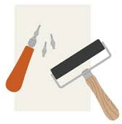
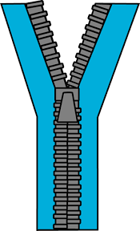
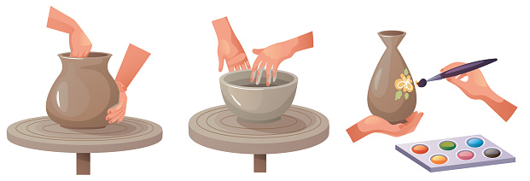



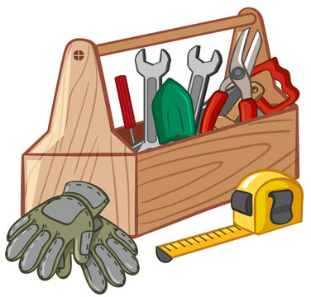
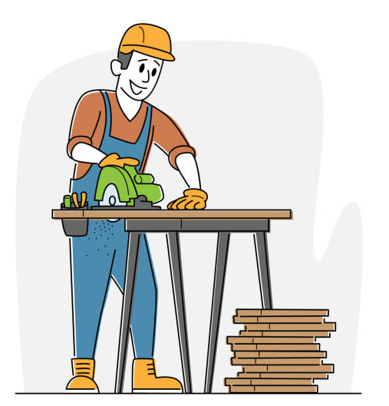


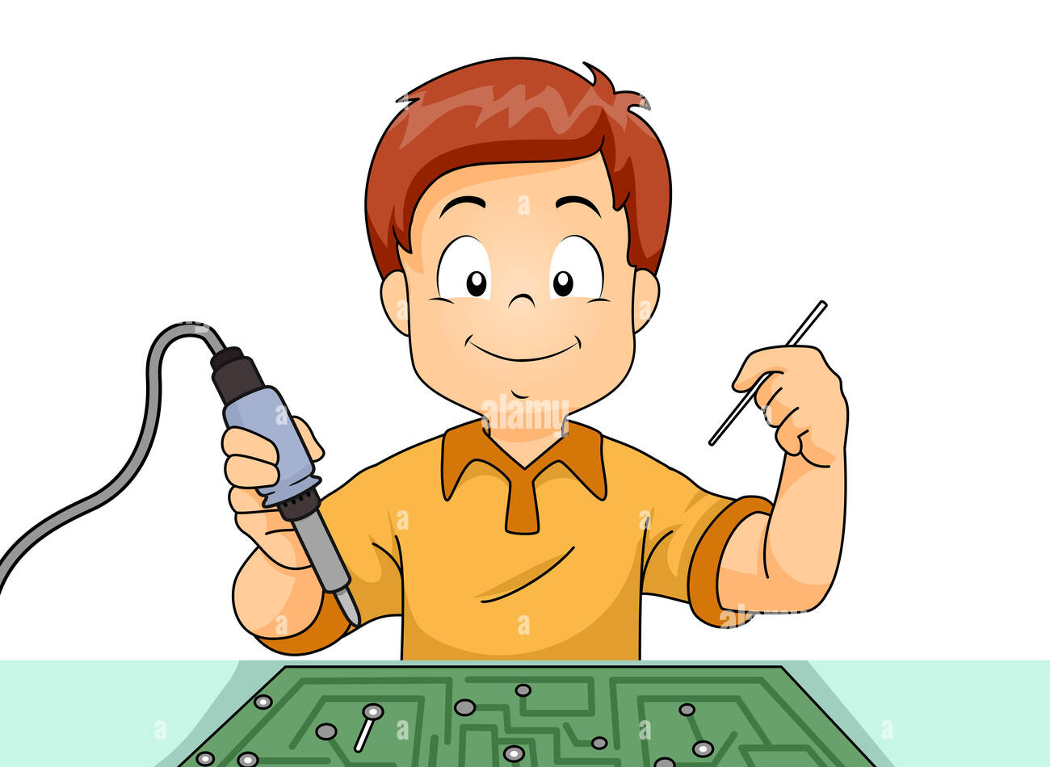

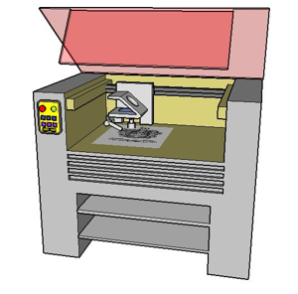
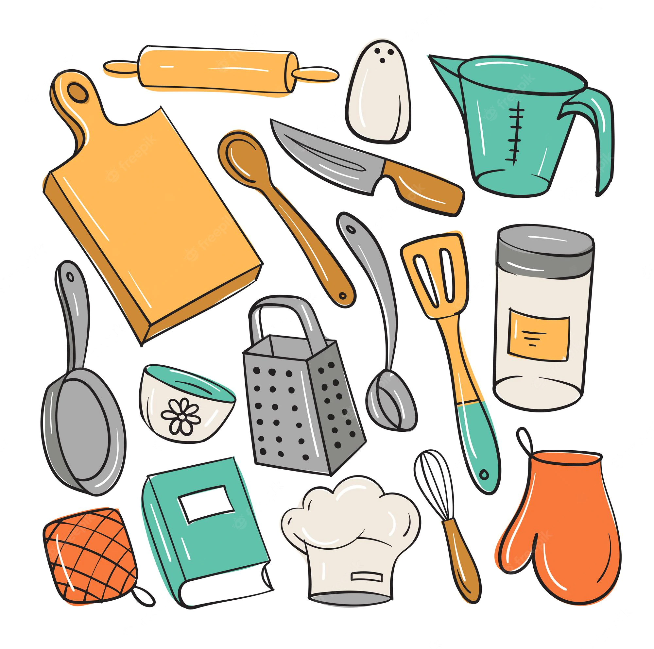


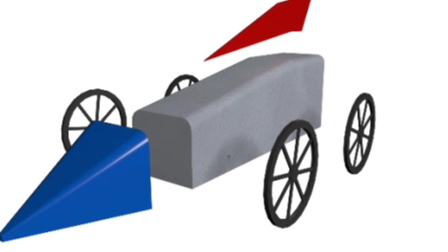

Design & Technology
KS3 Learning Journey
At The Barlow, the study of Design and Technology aims to inspire pupils to use creativity and imagination to design and produce high-quality prototypes and products. These should address real and relevant problems across a range of contexts, taking into account their own needs and those of others, as well as considering values, wants, and preferences. Through exploring both historical and contemporary examples of design and technology, pupils will develop a critical understanding of its influence on everyday life and the wider world. They will learn to analyse, evaluate, and test their own ideas and products, as well as those created by others. We also place strong emphasis on teaching pupils the principles of nutrition and the skills needed to cook. By fostering a love of cooking, we aim to unlock one of the most powerful forms of human creativity and self-expression
Photography
Advanced elements of photography
Textiles
Architectural-Inspired printed
Pencil Case
Year 9
Food & Nutrition
Advance Food prep and nutrition
3D Design
laser cut clock
Ceramics
3D Design and influential designers
Textiles
Ugly dolls
Pattern making
Engineering
Toy train
Essentials of engineering
Year 8
Food & Nutrition
Intermediate skills in Food preparation
3D Design
Exploring, shaping, & drawing
3D forms
Multi-materials
African-inspired textile, wood &
electronics lantern
Food & Nutrition
Basics in Food safety and nutrition
STEM
Race to the Line
CO₂-Powered Car Challenge
Year 7

