Slide 1


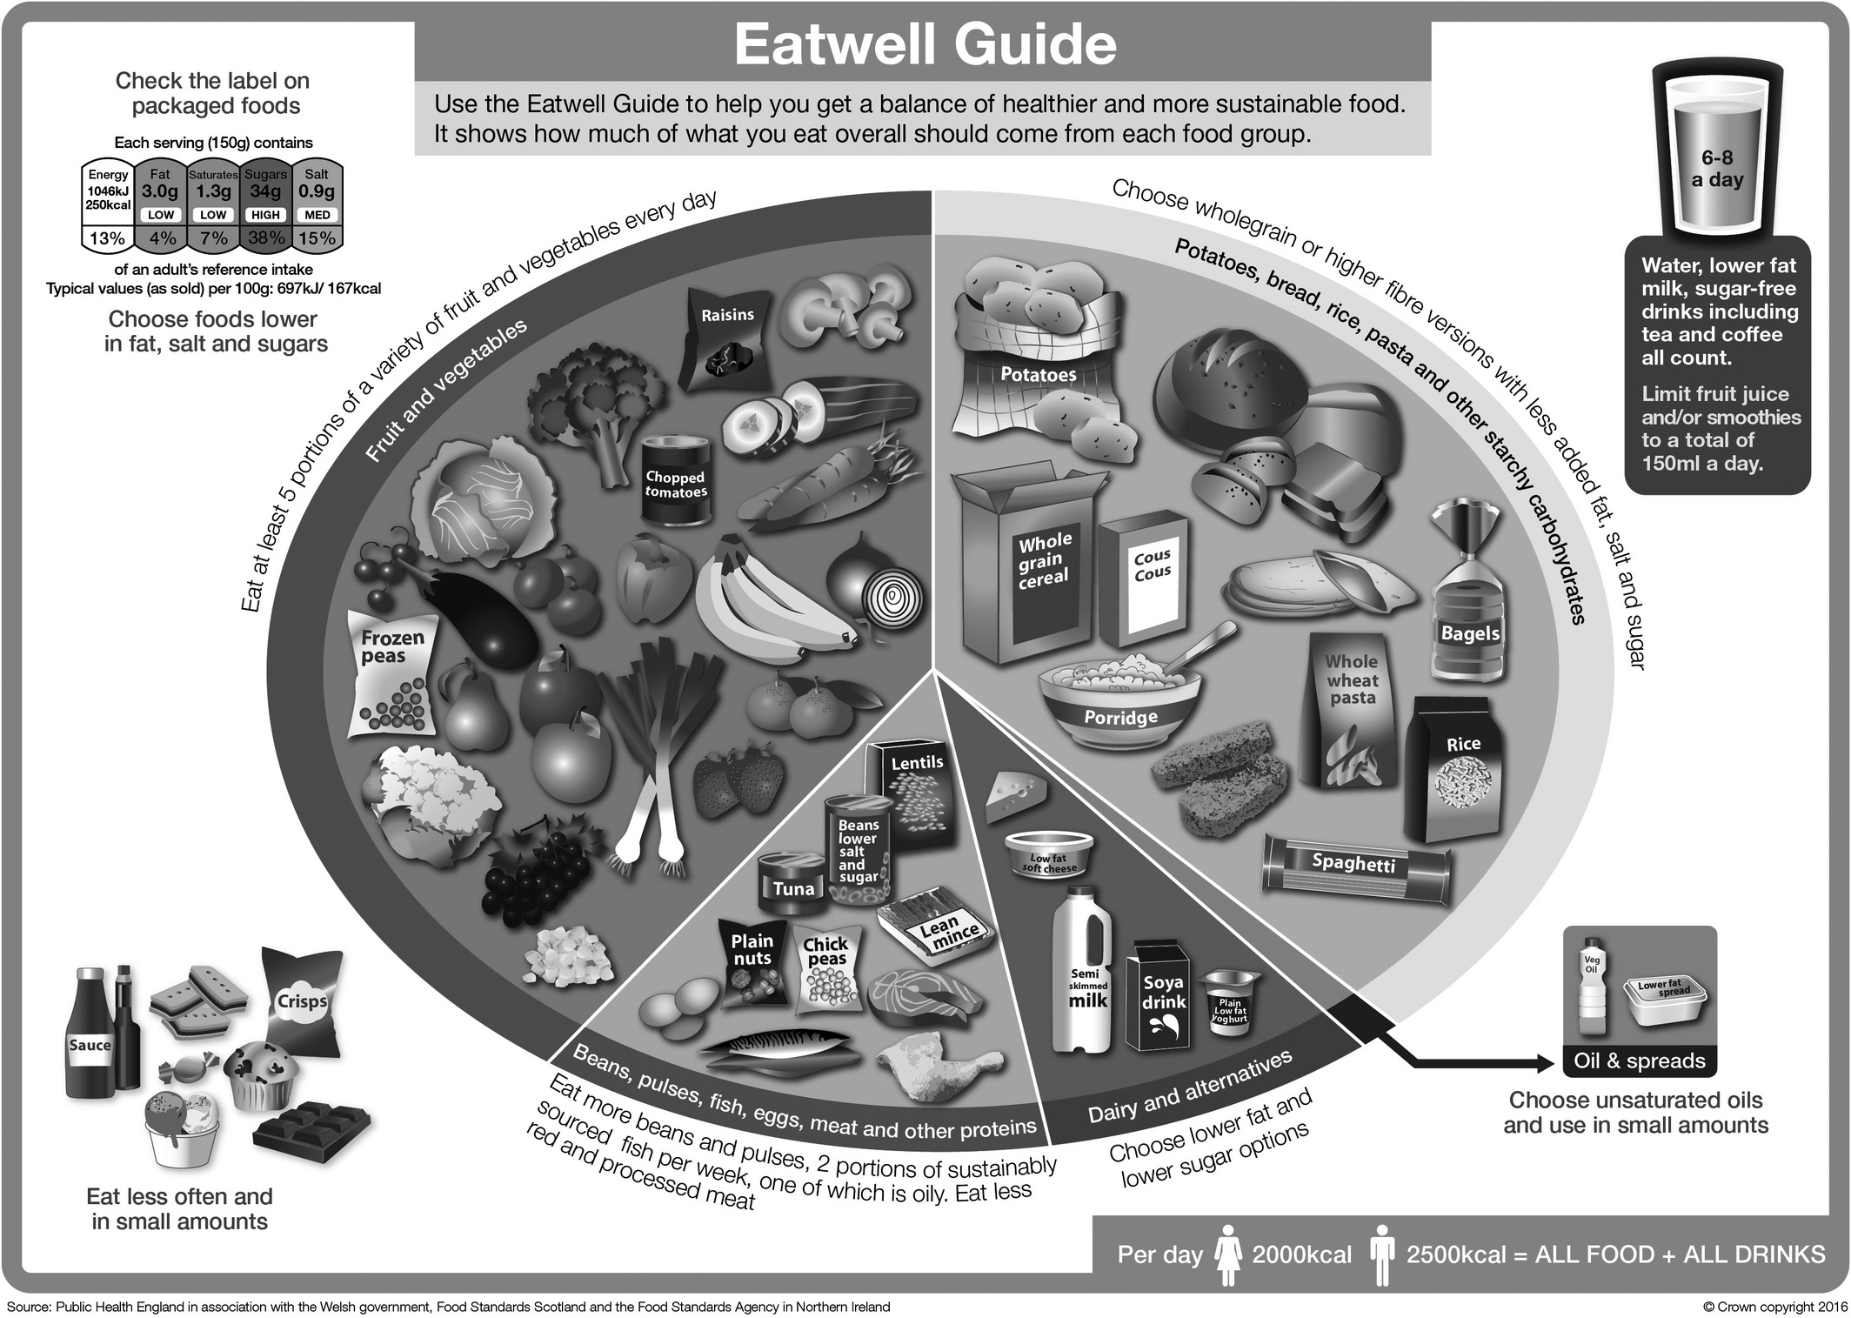





















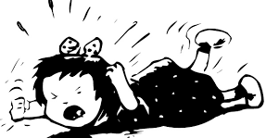







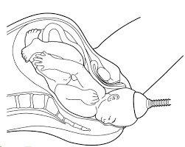









Child Development Learning Journey
Year 10
RO59 Coursework RO58 Coursework RO57 Exam
Year 11
Understand the development of a child from one to five years
Health and Well-being for Child Development
Create a safe environment and understand the nutritional
needs of children from birth to five years
Essential nutrient and their functions for children from birth to 5
How to evaluate, planning and preparation for a feed / meal
Nutritional needs for a child
from birth to five years
TOPIC AREA 4
EXAM REVISION
EXAM
Post – 16
Destination
TOPIC AREA 3
Plan for preparing a feed / meal
Review of RO57
Factors affecting suitability and choice
Choosing suitable equipment
For a childcare setting
Reasons why
accidents can happen
Types of Childhood
accidents
TOPIC AREA 2
TOPIC AREA 1
COURSEWORK RO58
YEAR
11
Types of essential
equipment
Accidents and accident prevention in a childcare setting
Physical, intellectual and social development norms from 1 to 5 years
Plan and evaluate play activities for a child aged 1 to 5 years for a chosen area of development
Intellectual development
Stages and types of play and how they help development
Physical development
TOPIC AREA 4
TOPIC AREA 1
TOPIC AREA 2
TOPIC AREA 3
COURSEWORK RO59
Creative skills
Observation of a child
Observe the development of a child aged 1 to 5 years
Social development
YEAR
Recognising common hazards and how to prevent them
Emergency Treatment
Signs and Symptoms of illness in children
10
TOPIC
AREA 4
C
CHILD SAFETY
CHILDHOOD HEALTH
Approaches to
discipline
Social Safety
Safety labelling
Needs of an ill child
Acceptable patterns of behaviour
DEVELOPMENTT NEEDS OF CHILD
Understand the importance of parenting classes
Role of birth partner
Choices for delivery
Stages of labour
Postnatal checks
on Newborn
Warmth, feeding, shelter
Routine,
love and
support
Identify and explain routine tests
PREPARATION FOR BIRTH
TOPIC
AREA 3
POSTNATAL CHECKS
POSTNATAL CARE
Fresh air, cleanliness, exercise, stimulation, routine,
ANTENATAL CARE
Pain relief
Postnatal care
for the mother and baby
Optimum conditions for
development
Identify the roles of different health professionals
Specialised diagnostic tests
Methods of assisted delivery
TOPIC AREA 2
How reproduction takes place
YEAR
Understand the importance of antenatal classes
REPRODUCTION
PRE-CONCEPTION HEALTH
TOPIC AREA 1
BRIDGING COURSE TO CHILD DEVELOPMENT
10&11
Recognise the signs
and symptoms of
pregnancy
Identify the structure/function of the male and female reproduction system
Recognise and evaluate
methods of contraception
Factors affecting Pre-conception for men and woman health
Exam content started after coursework is completed.
Childhood illness

